Slide 1
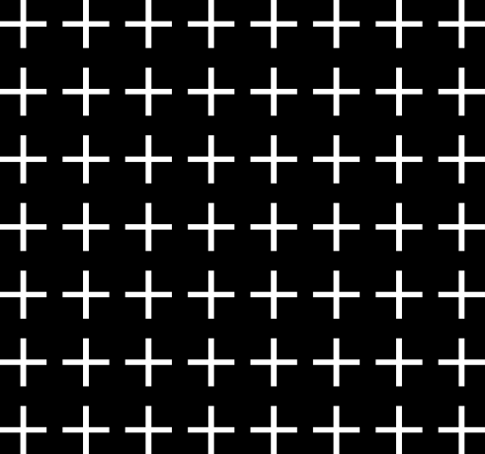
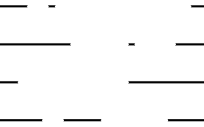

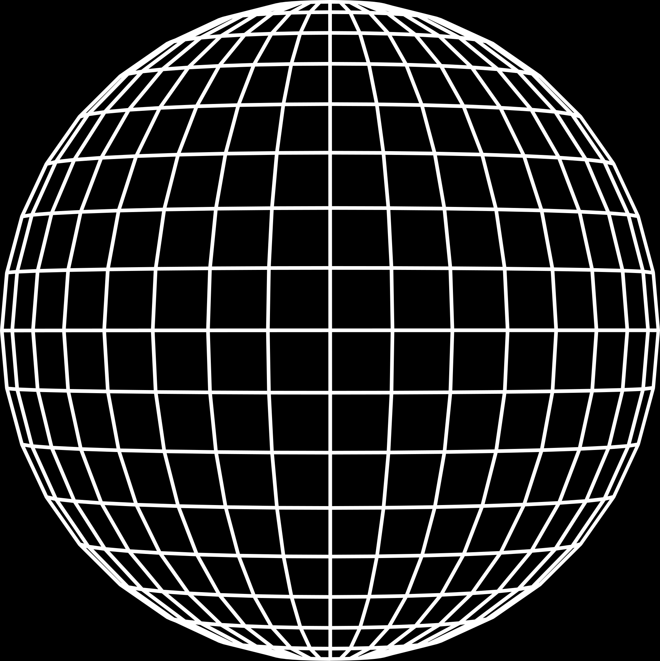
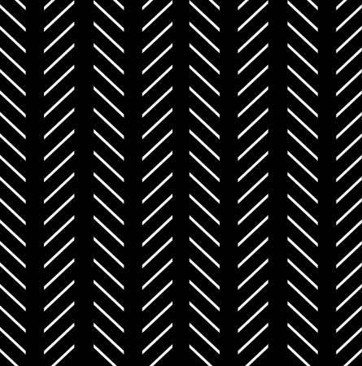
RAIL GUARD:
SECURE RAILWAYS WITH SMART CCTV
TEAM META MINDS

Slide 2

CONTEXT:
Problem Statement
Use Case Diagram
Tech Stack
Crowd Management Model
Overview
Use Cases
Working model
Crime Detection Model
Overview
Use Cases
Working model
Analysis
UI
Cloud Architecture diagram
Future Scope

Slide 3
PROBLEM STATEMENT:
We seek to address safety and security concerns at railway stations using the existing CCTV cameras development of a website offering the following capabilities:
Employing ML models on CCTV networks for crowd management.
Detecting criminal activities in CCTV footage, alerting respective authorities promptly, and maintaining records of case resolutions.
Providing graphical analysis for the aforementioned data.
Identification and prevention of suicidal activities.

Slide 4

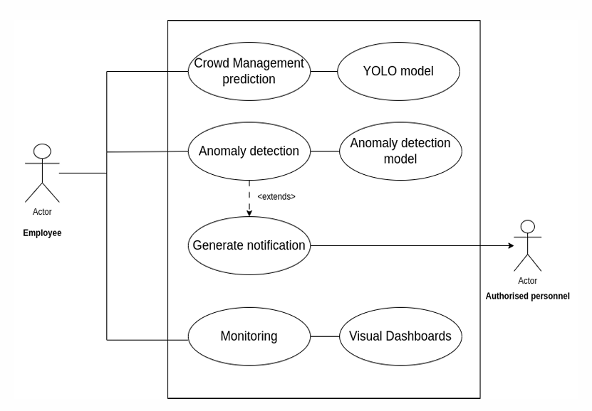

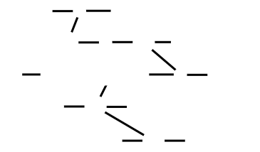
DIAGRAM:
USE CASE DIAGRAM :

Slide 5











TECH STACK
Programming Languages:
Frameworks:
Frontend Development:
Cloud Platform :

Slide 6
Crowd Management Model
Utilizes YOLOv7 model to analyze crowd size and dynamics in real-time.
Takes real time video as an input.
Detects the objects present in the video by adding bounding boxes with confidence levels.
Filtering the input to only detect people.
Revising the code to implement the count function.
Physical annotated inputs to improve accuracy.
Comparison between

Slide 7
USE CASES/UTILIZATION :
Assigning individuals or groups to waiting rooms based on crowd density and distribution can be performed.
Adapting resource allocation (staff, security, facilities) dynamically according to crowd fluctuations.
Provides real-time alerts and recommendations for immediate action in critical scenarios.

Slide 8
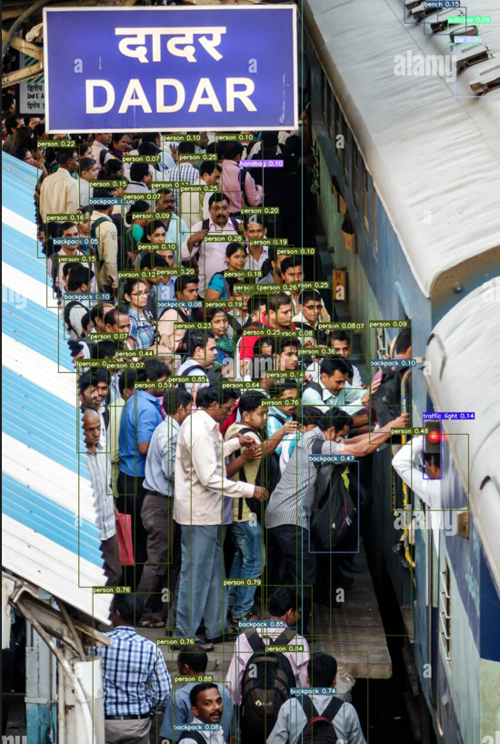
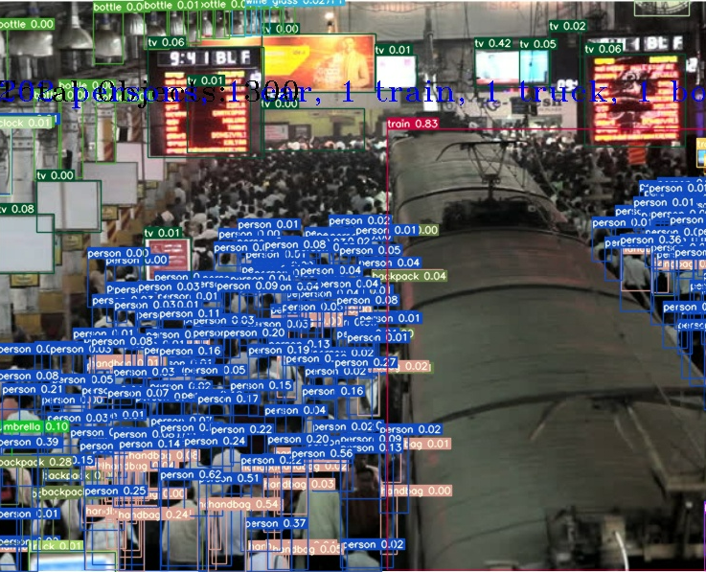
WORKING MODEL

Slide 9
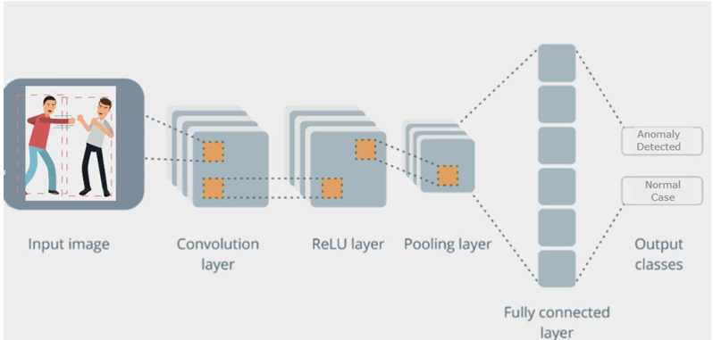
Crime Detection Model
Anomaly detection model is used to detect when a crime scene
is captured and notify the authorities about it.
Basic flow of the logic is:
Getting the video as an input.
Extracting the frames from the video and preparing the
dataset.
Creating a LRCN model using Tensorflow Keras API initiating accurate Convolution layers, Pooling layers, Dropout layers and LSTM layers.
Training the model by fitting it through the multiple convolution layers and an early callback to prevent overfitting.
Visualization of accuracy through multiple epochs.
Predicting the outcome by providing a video.

Slide 10
USE CASES/UTILIZATION :
Employs machine learning algorithms to detect unusual or abnormal patterns in behavior, helping identify potential criminal activities.
Classifies different activities such as accidental pushing, suicidal tendencies, and assault.
Sends instant notifications to employees and relevant personnel when suspicious activities are detected, enabling quick response.

Slide 11


ANALYSIS
Accuracy of the model based on deep learning techniques used :
USING CNN + RNN
USING LRCN

Slide 12
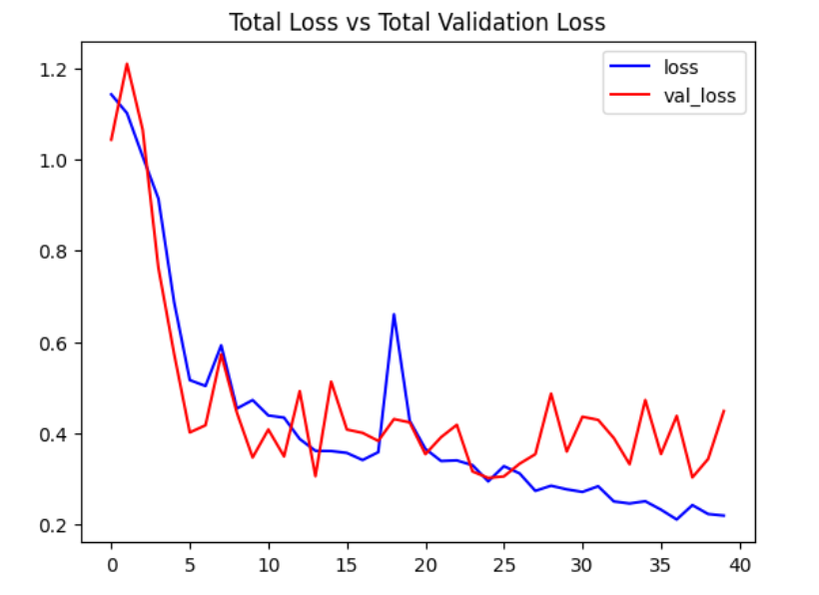
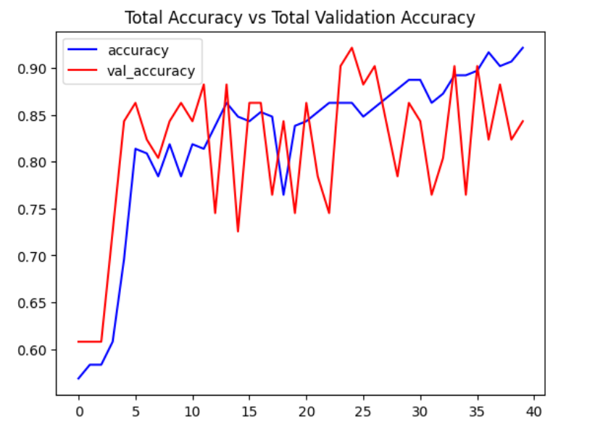
ANALYSIS
Analysis of total loss and accuracy metrics

Slide 13
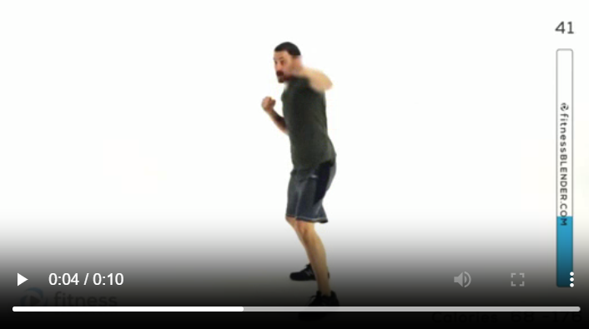
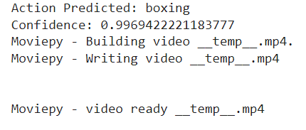
WORKING MODEL

Slide 14
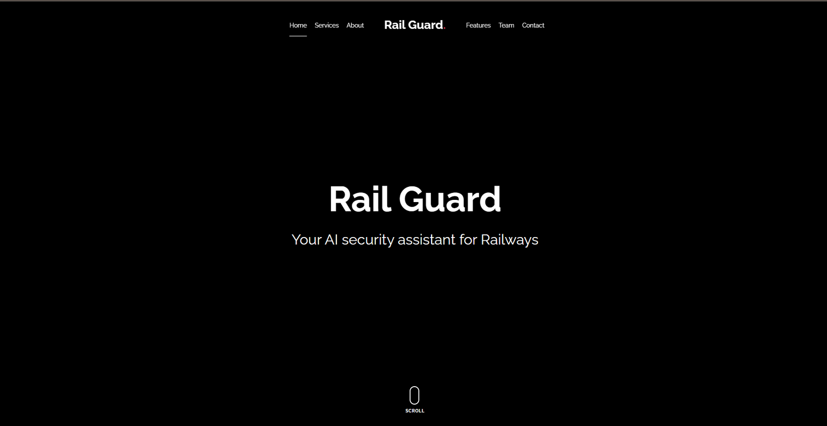
UI
LANDING PAGE :

Slide 15
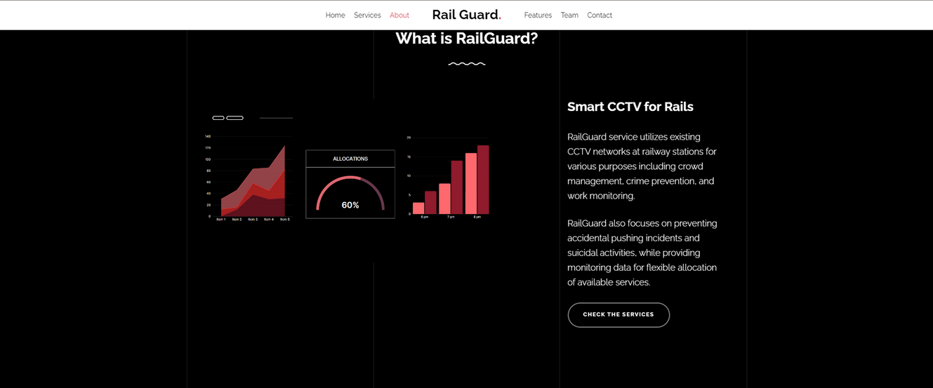
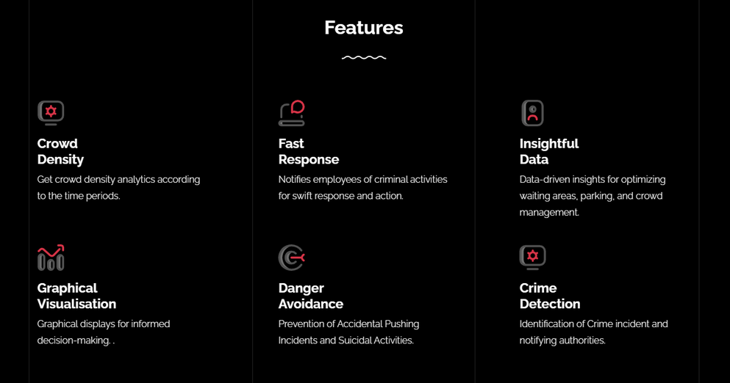
UI
ABOUT US:
FEATURES:

Slide 16
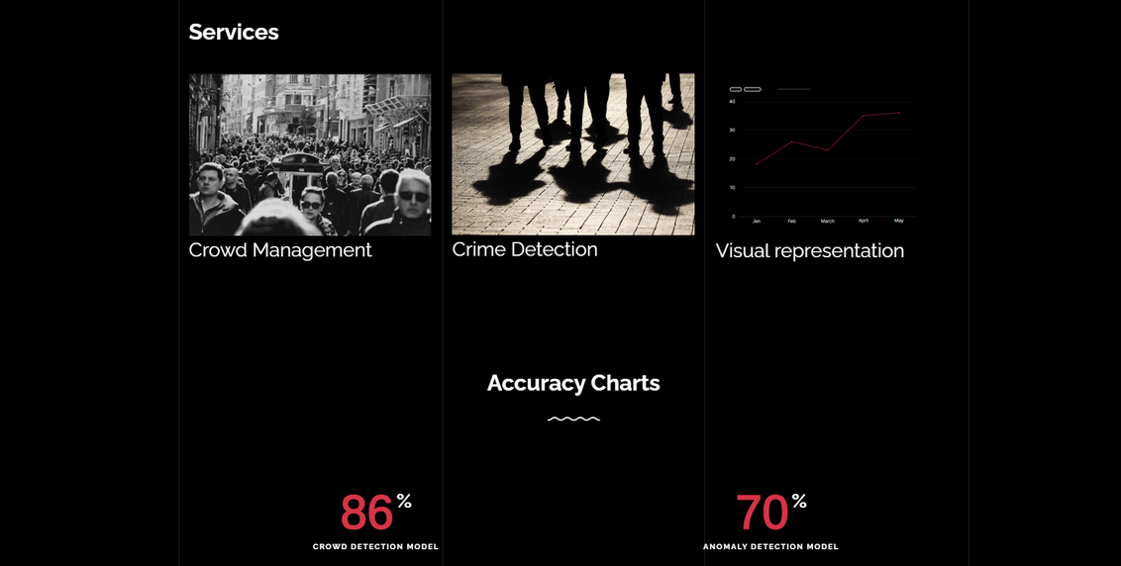
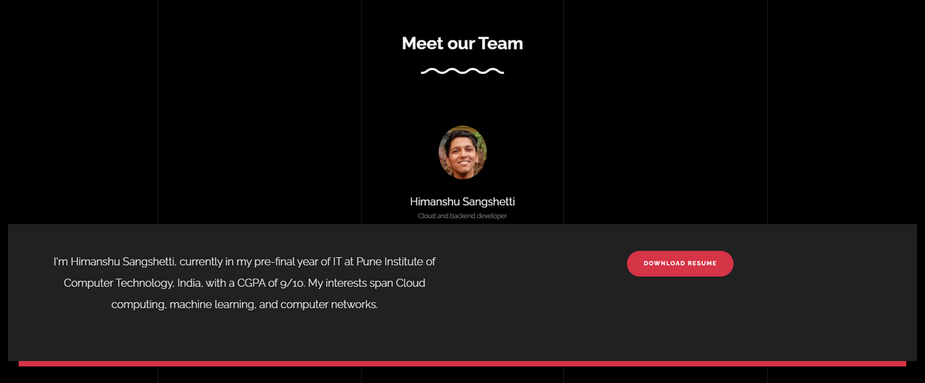
UI
SERVICES AND ACCURACY:
TEAM :

Slide 17
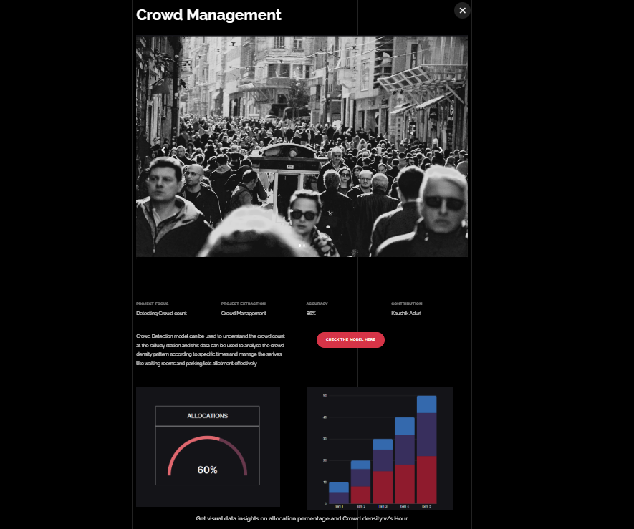
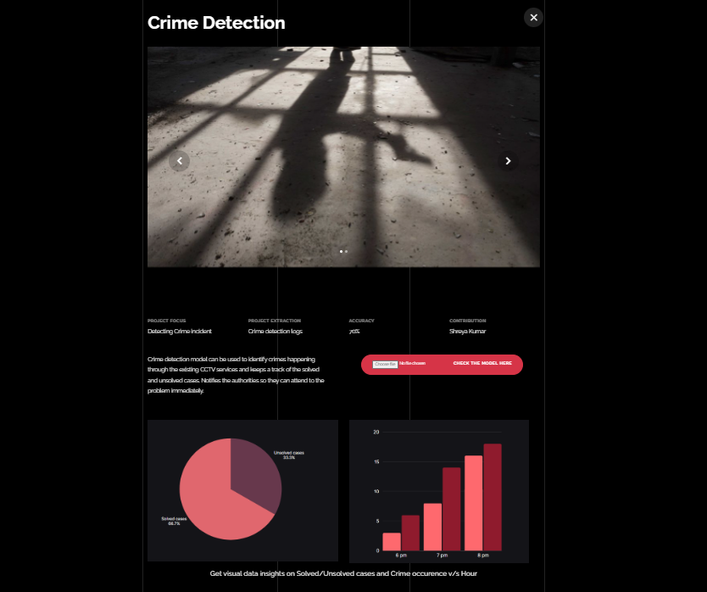
UI
SERVICES PAGE :

Slide 18
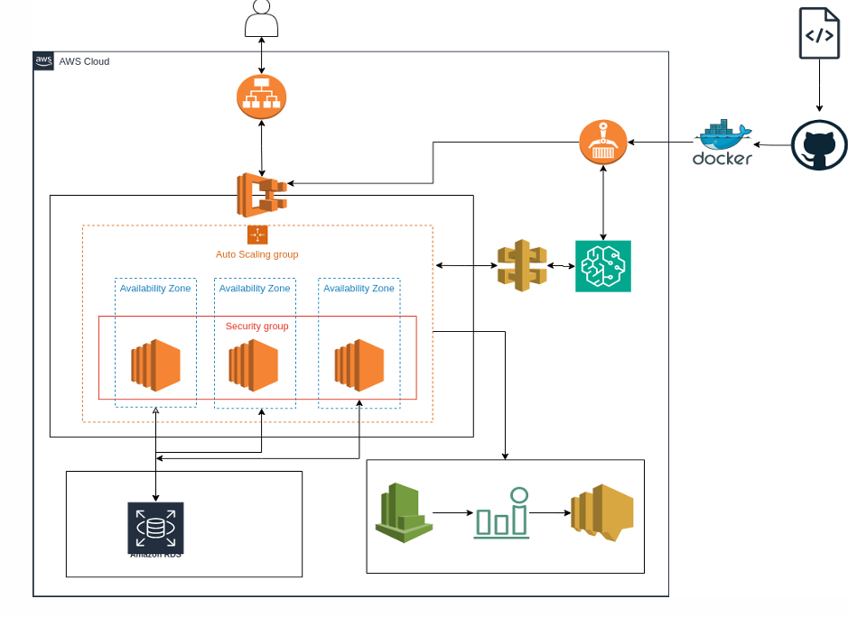
DIAGRAM:
CLOUD ARCHITECTURE
DIAGRAM :
(Future Scope)
WHY CLOUD?

Slide 19
FUTURE SCOPES
Migrating the infrastructure on cloud.
Collaborating with transportation authorities and railway operators to deploy our solution across multiple stations.
Refining the machine learning models to improve its accuracy and speed.

Slide 20


THANK YOU!

